Slide 1


Scientific Machine Learning
Lecture 5: Regression (Part 3)
孟旭辉
数学与统计学院数学与应用学科交叉创新研究院
办公室：欣苑2栋111室
Email：xuhui_meng@hust.edu.cn
https://github.com/XuhuiM/SciML-Course
3/22/2024

Slide 2
Contents
Deep Neural Networks
Random feature method
Spectral bias of DNNs

Slide 3
Contents
Deep Neural Networks
Random feature method
Spectral bias of DNNs

Slide 4

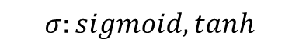


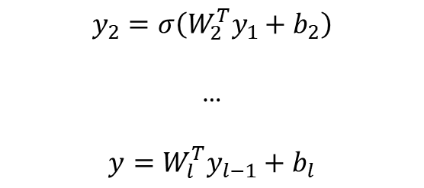
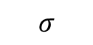
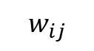



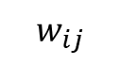
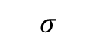

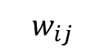

Deep Neural Networks (DNNs): Universal Approximation Theorem
$$w_{ij}$$
$$w_{ij}$$
$$σ$$
$$σ$$
$$y_{1}=σ(W_{1}^{T}x+b_{1})$$
$$w_{ij}$$
$$σ$$
$$σ$$
$$y_{2}=σ\left(W_{2}^{T}y_{1}+b_{2}\right)$$
…
$$y=W_{l}^{T}y_{l−1}+b_{l}$$
y
$$σ$$
$$σ$$
$$σ$$
$$σ$$
$$σ:sigmoid, tanh$$
Standard multilayer feedforward networks are capable of approximating any measurable function to any desired degree of accuracy
Convergence rate increases as the number of hidden units grows
K. Hornik, etc, Neural Networks, 1989

Slide 5
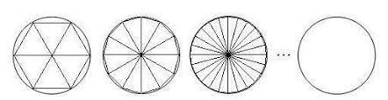

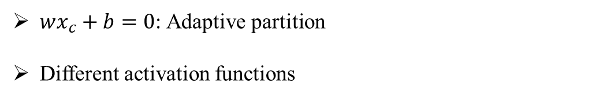
On Universal Approximation Theorem
$wx_{c}+b=0$: Adaptive partition
Different activation functions

Slide 6


Convolutional neural networks

Slide 7
Contents
Deep Neural Networks
Random feature method
Spectral bias of DNNs

Slide 8
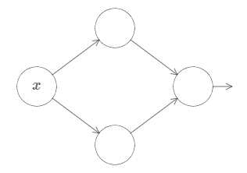

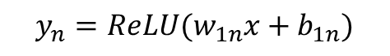
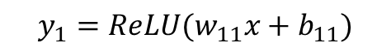


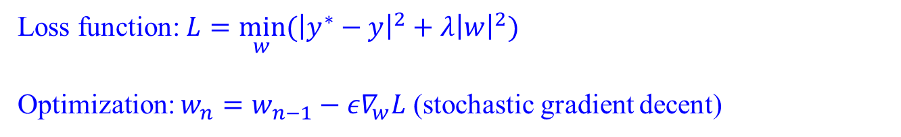
NN with single hidden layer: Random weights/biases
$${y_{1}=ReLU(w}_{11}x+b_{11})$$
$$w_{11}x+b_{11}$$
…
$$u=\sum_{i}{{w_{i}y}_{i}+b}$$
$$w_{12}x+b_{12}$$
$${y_{n}=ReLU(w}_{1n}x+b_{1n})$$
Loss function: $L={\min_{w}⁡(\left|y^{∗}−y\right|}^{2}+λ{\left|w\right|}^{2})$
Optimization: $w_{n}=w_{n−1}−{ε∇}_{w}L$ (stochastic gradient decent)

Slide 9
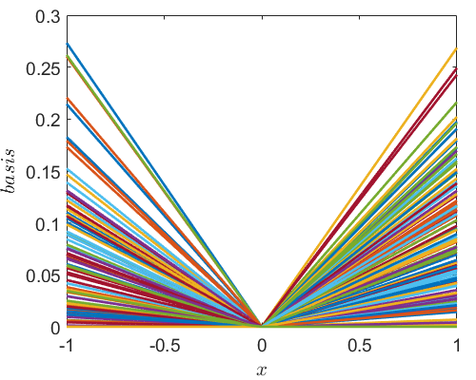
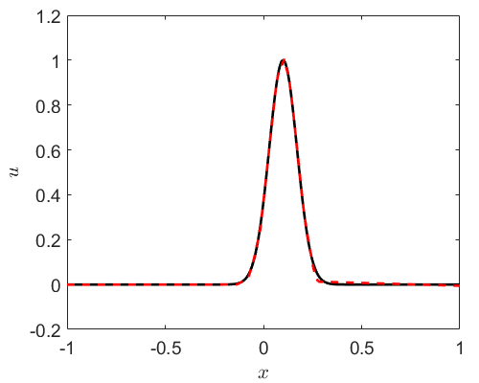
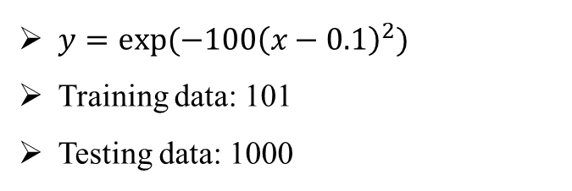
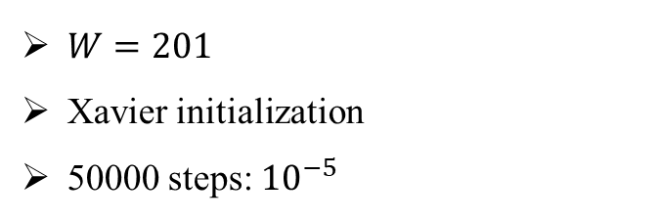
ReLU NN with a single hidden layer
$y=exp⁡(−100{\left(x−0.1\right)}^{2})$
Training data: 101
Testing data: 1000
$W=201$
Xavier initialization
50000 steps: ${10}^{−5}$

Slide 10
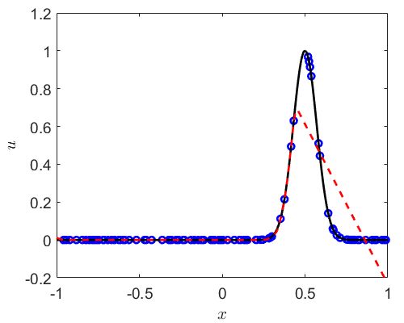
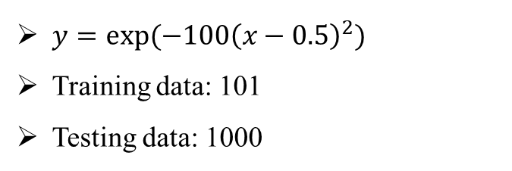
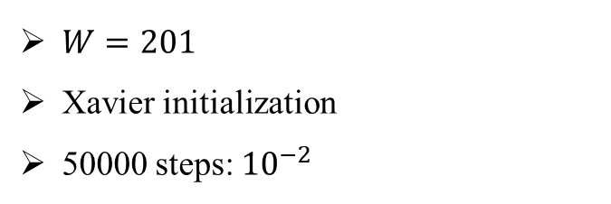
ReLU NN with a single hidden layer
$y=exp⁡(−100{\left(x−0.5\right)}^{2})$
Training data: 101
Testing data: 1000
$W=201$
Xavier initialization
50000 steps: ${10}^{−2}$

Slide 11
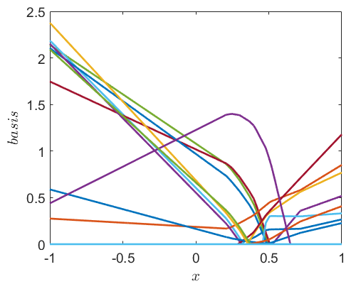
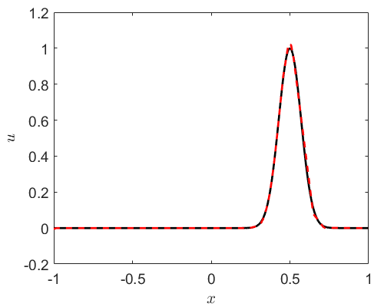
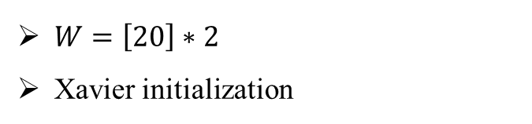
ReLU NN with 2 hidden layers
$y=exp⁡(−100{\left(x−0.5\right)}^{2})$
Training data: 101
Testing data: 1000
$W=\left[20\right]∗2$
Xavier initialization

Slide 12
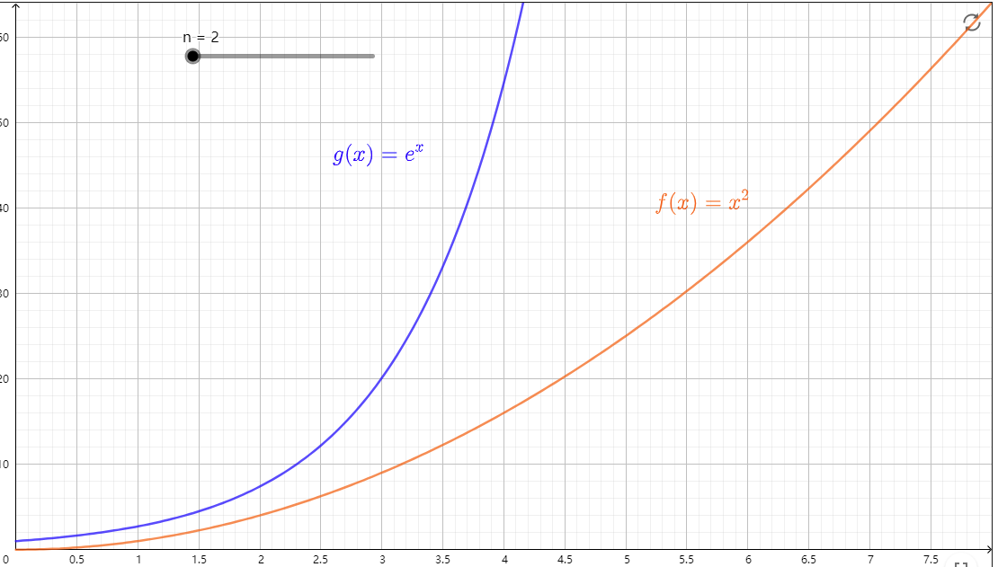
On the number of linear response regions
Montufar, etc, 2014

Slide 13

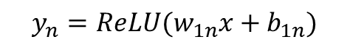
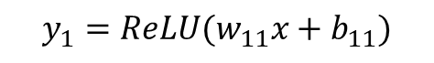


NN with single hidden layer: Random weights/biases
$${y_{1}=ReLU(w}_{11}x+b_{11})$$
$$w_{11}x+b_{11}$$
…
$$u=\sum_{i}{{w_{i}y}_{i}+b}$$
$$w_{12}x+b_{12}$$
$${y_{n}=ReLU(w}_{1n}x+b_{1n})$$
Randomly initialized $w_{1n},b_{1n}→w_{1n}x+b_{1n}=0$

Slide 14
NN with single hidden layer: Random weights/biases
$${y_{1}=ReLU(w}_{11}x+b_{11})$$
$$w_{11}x+b_{11}$$
…
$$u=\sum_{i}{{w_{i}y}_{i}+b}$$
$$w_{12}x+b_{12}$$
$${y_{n}=ReLU(w}_{1n}x+b_{1n})$$
$w_{i}, b→$stochastic gradient descent/least squares

Slide 15

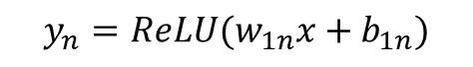
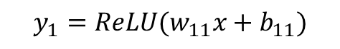


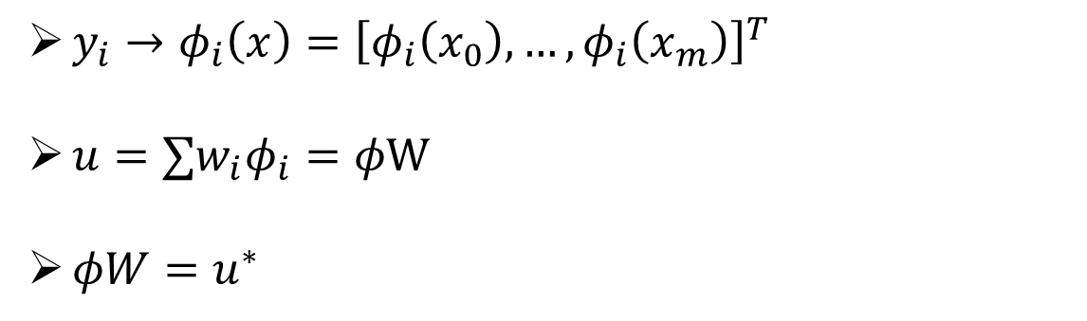
NN with single hidden layer: Random weights/biases
$${y_{1}=ReLU(w}_{11}x+b_{11})$$
$$w_{11}x+b_{11}$$
…
$$u=\sum_{i}{{w_{i}y}_{i}+b}$$
$$w_{12}x+b_{12}$$
$${y_{n}=ReLU(w}_{1n}x+b_{1n})$$
$y_{i}→φ_{i}\left(x\right)={\left[φ_{i}\left(x_{0}\right),…,φ_{i}\left(x_{m}\right)\right]}^{T}$
$u=∑w_{i}φ_{i}=φW$
$φW=u^{∗}$

Slide 16

ReLU NN with a single hidden layer
$${y_{1}=ReLU(w}_{11}x+b_{11})$$
$$w_{11}x+b_{11}$$
…
$$u=\sum_{i}{{w_{i}y}_{i}+b}$$
$$w_{12}x+b_{12}$$
$${y_{n}=ReLU(w}_{1n}x+b_{1n})$$
Convergence rate:
$$f\left(x\right)=a_{0}+a_{1}x+a_{2}x^{2}+…$$
Taylor expansion:
$$f\left(x\right)=f\left(x_{0}\right)+f^{′}\left(x_{0}\right)Δx+\frac{1}{2}f^{′′}\left(x_{0}\right)Δx^{2}+…$$
$$=f\left(x_{0}\right)+f^{′}\left(x_{0}\right)Δx+O(Δx^{2})$$

Slide 17
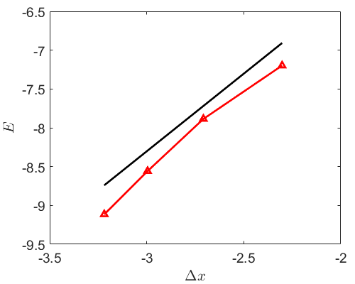
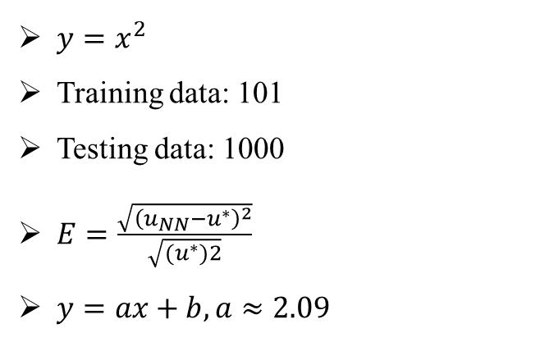

ReLU NN with a single hidden layer
Convergence rate:
$$f\left(x\right)=a_{0}+a_{1}x+a_{2}x^{2}+…$$
Taylor expansion:
$$f\left(x\right)=f\left(x_{0}\right)+f^{′}\left(x_{0}\right)Δx+\frac{1}{2}f^{′′}\left(x_{0}\right)Δx^{2}+…$$
$$=f\left(x_{0}\right)+f^{′}\left(x_{0}\right)Δx+O(Δx^{2})$$
$y=x^{2}$
Training data: 101
Testing data: 1000
$E=\frac{\sqrt{{\left(u_{NN}−u^{∗}\right)}^{2}}}{\sqrt{{(u}^{∗})2}}$
$y=ax+b,a≈2.09$
slope: 2

Slide 18
Contents
Deep Neural Networks
Random feature method
Spectral bias of DNNs

Slide 19
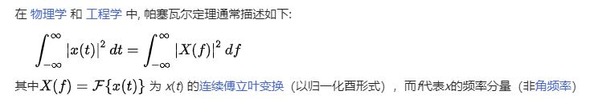
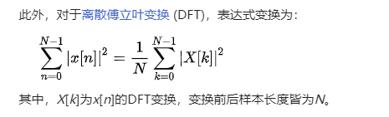
Loss function – Parseval’s theorem
From Wiki

Slide 20
Loss function – Parseval’s theorem
Physical space
Frequency domain

Slide 21
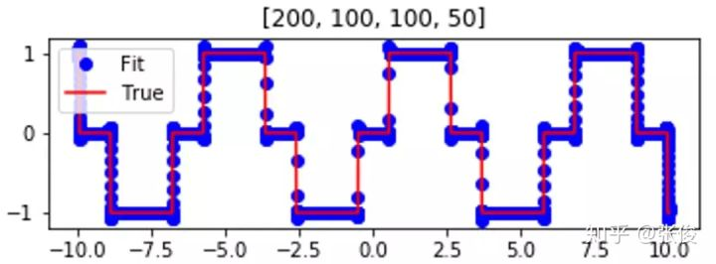
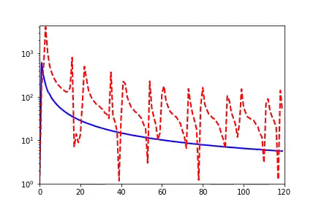
Spectral bias of NNs
DNNs initialized with small parameters often fit target functions from low to high frequencies during training process.
Xu, et al, 2019

Slide 22
Spectral bias of NN
Output of DNN:
Gradient decent:
Xu, et al, 2019

Slide 23
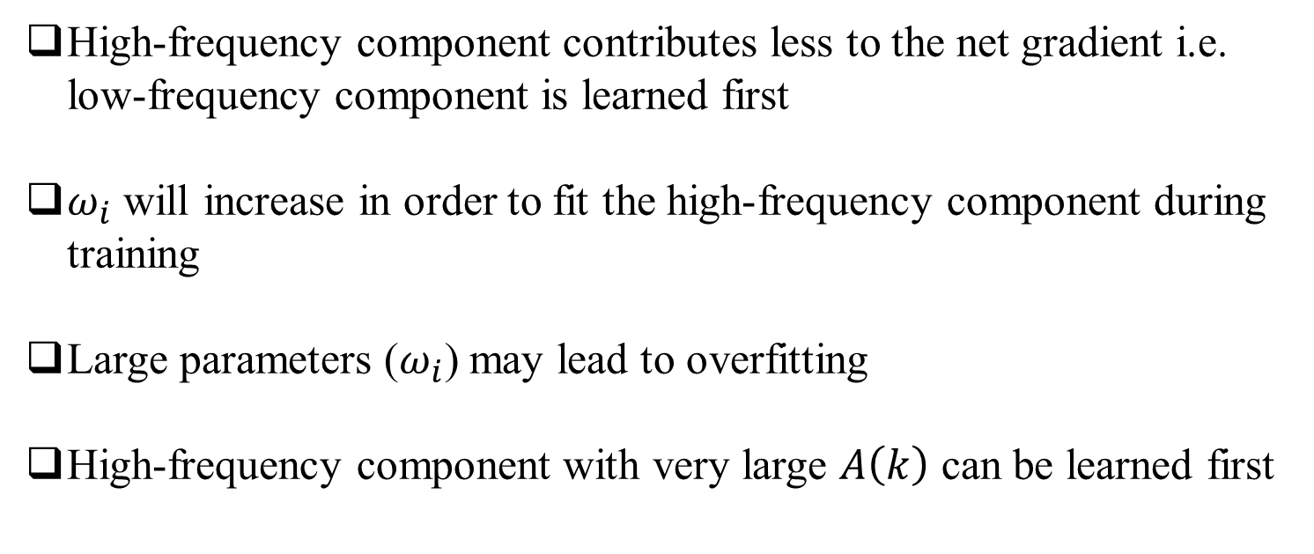
Spectral bias of NN
High-frequency component contributes less to the net gradient i.e. low-frequency component is learned first
$ω_{i}$ will increase in order to fit the high-frequency component during training
Large parameters ($ω_{i}$) may lead to overfitting
High-frequency component with very large $A\left(k\right)$ can be learned first
Xu, et al, 2019

Slide 24
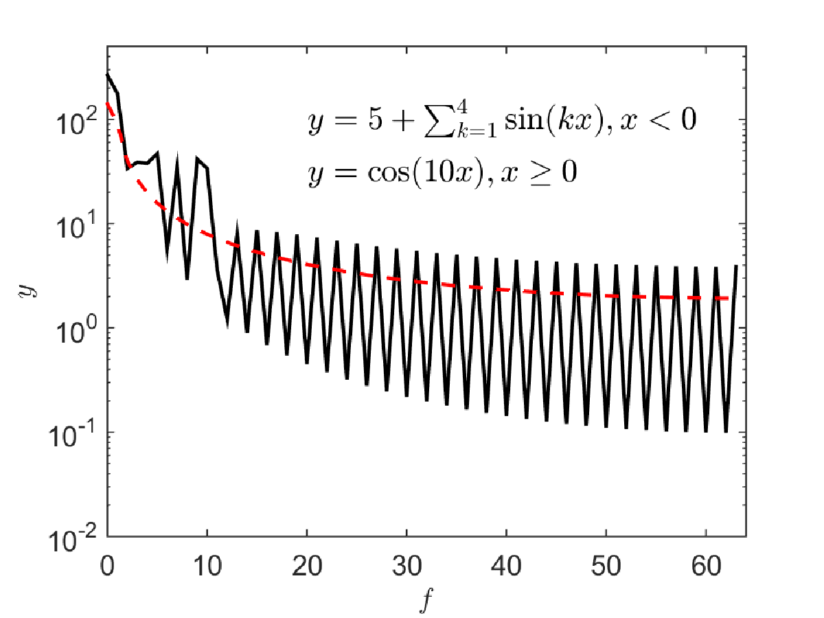
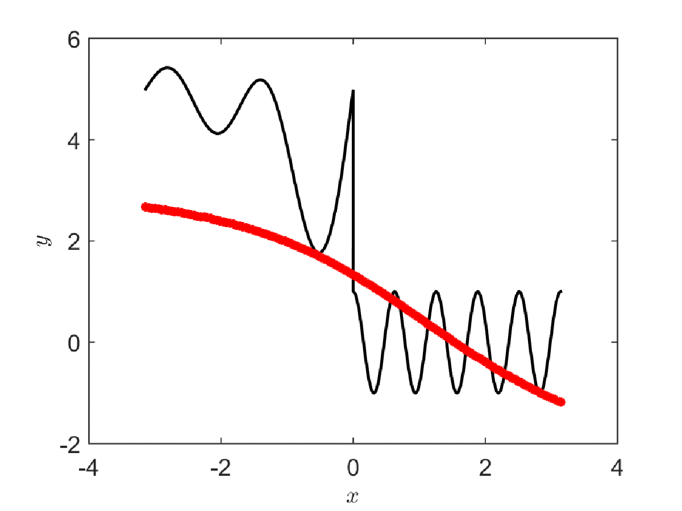
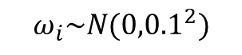
Spectral bias of NN
$$ω_{i}\sim N({0,0.1}^{2})$$

Slide 25
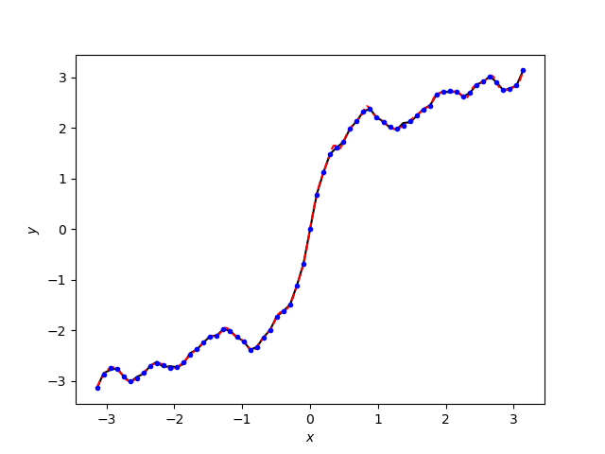
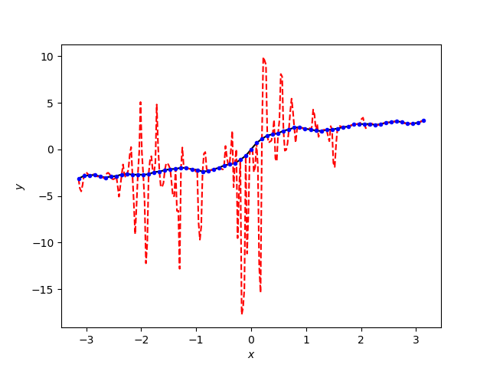
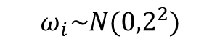
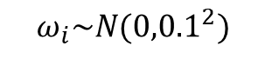
Spectral bias of NN
Red: DNN
Blue: training data
Black: Ref
$$ω_{i}\sim N({0,0.1}^{2})$$
$$ω_{i}\sim N({0,2}^{2})$$

Slide 26
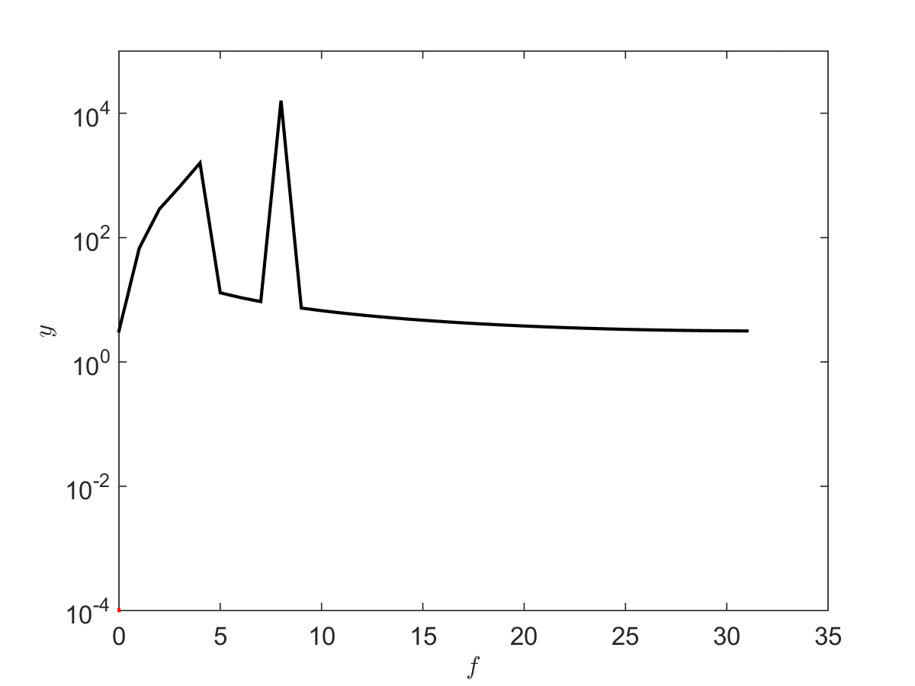
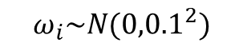
Spectral bias of NN
$$ω_{i}\sim N({0,0.1}^{2})$$

Slide 27
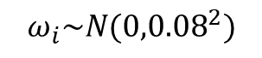
Spectral bias of NN: Image processing
$$ω_{i}\sim N({0,0.08}^{2})$$
Xu, et al, 2019

Slide 28
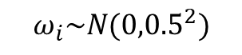
Spectral bias of NN: Image processing
$$ω_{i}\sim N({0,0.5}^{2})$$
Xu, et al, 2019

Slide 29

第一次作业
一维$函数拟合问题$
研究训练点数目、网络结构（隐藏层层数、激活函数等）对预测精度的影响
作业方式：代码+报告
时间：三周

Slide 30

Thank you for your attention!

